Slide 1
Jacksonville Waterways Commission
September 15, 2021

Slide 2
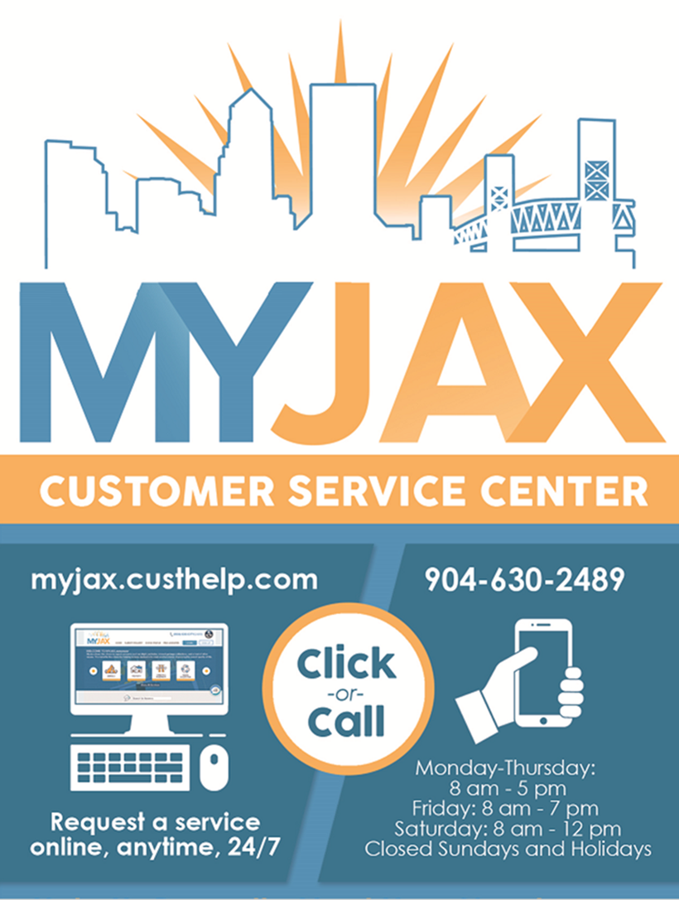
263,029 Agent Assisted English Phone Calls
1,684 Agent Assisted Spanish Phone Calls
246,652 System Assisted Calls
371,918 Service Requests
858,013 Online Visits
648,070 Mobile App Visits
21,115 Emails
3,515 Walk-in
180 Chat Sessions
Pilot program began May 2021
Wednesday & Thursday 10 am – 3 pm
23,567 Public Records Requests Processed
3,550 Scheduled Appointments
Emergency Financial Assistance Appointments
2
* Data Time Period: October 1, 2020 – August 31, 2021
Notes:
MyJax is more than a call center in addition to answering phone calls, we respond to emails, assist in person customers at the St James Information desk and in our office at Ed Ball, post public notices in both locations, respond to email requests, work online service requests, coordinate the completion of Public Records Requests, Schedule emergency financial assistance appoints and in May we started a Chat pilot program Wednesday & Thursday 10 am – 3 pm

Slide 3
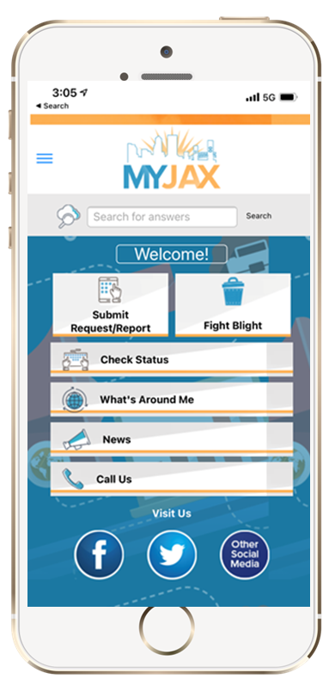
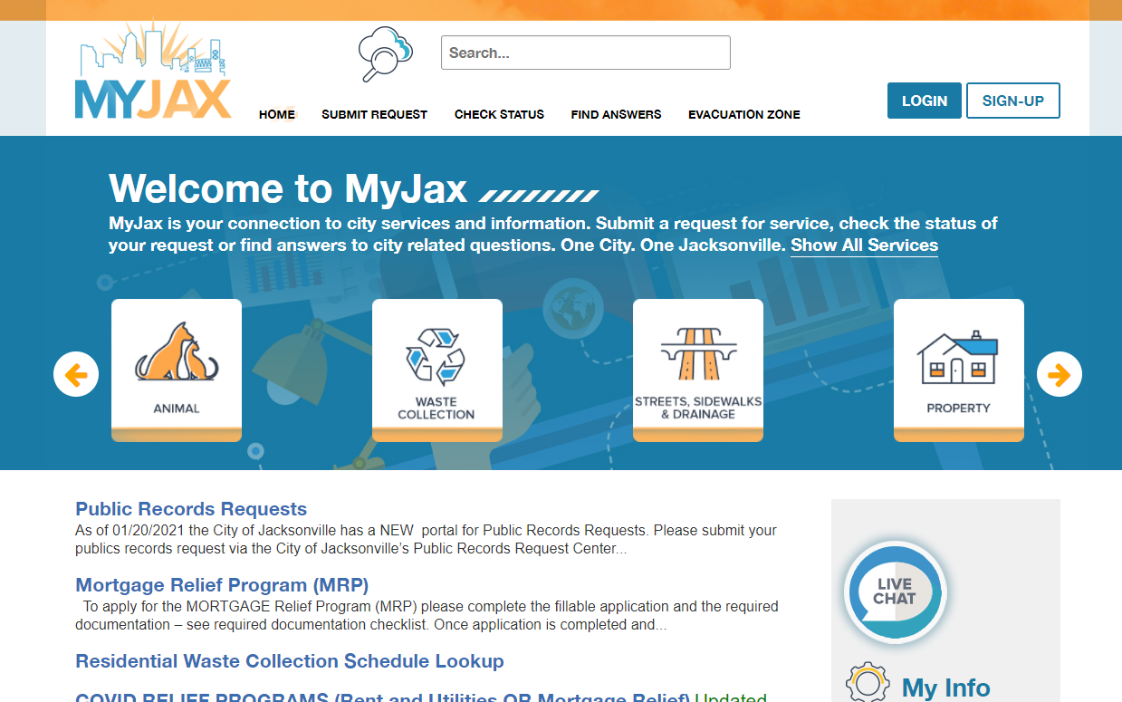
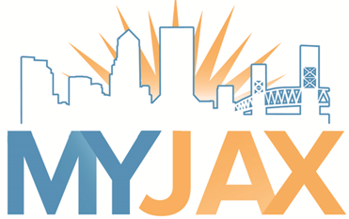
CUSTOMER PORTAL
myjax.custhelp.com
3
Notes:
The fastest way to report issues is using one of our online portals.
When customers created an account they will receive updates on their service requests.

Slide 4
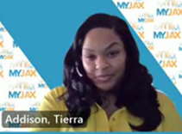
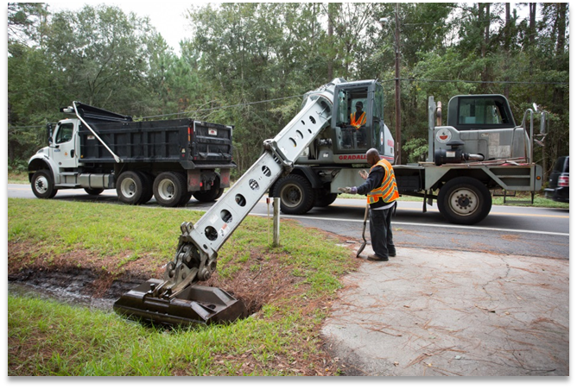
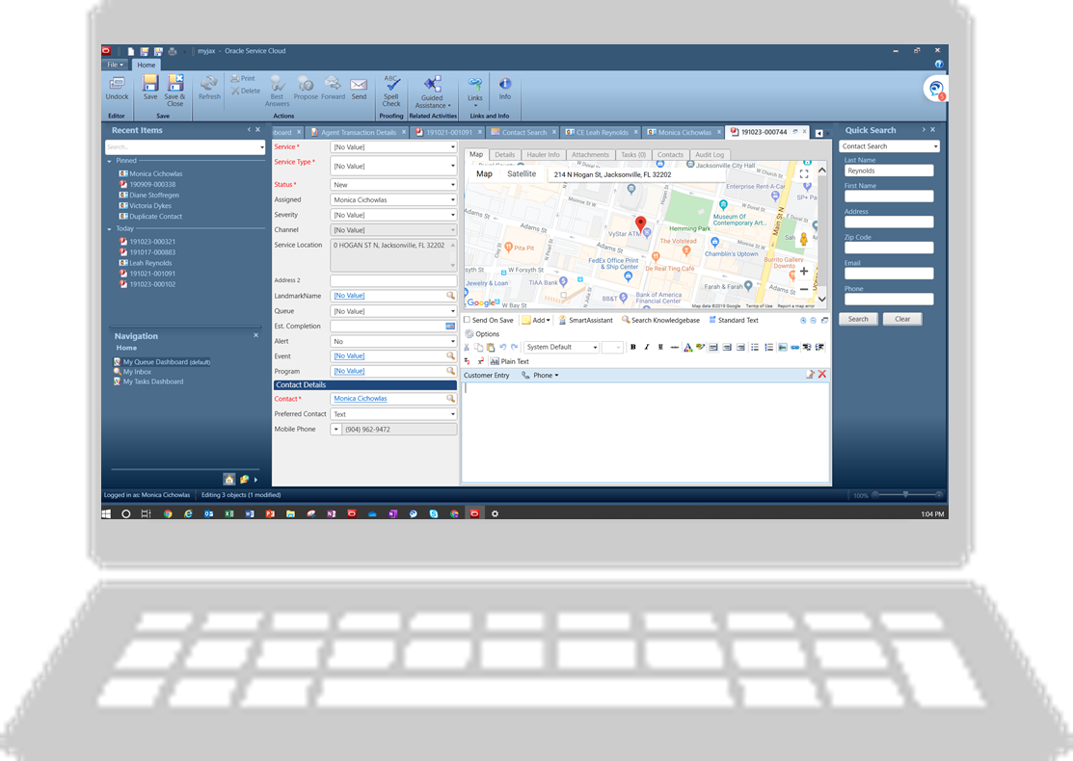
HOW IT WORKS
630-CITY(2489)
A Customer Service Representative answers the phone and provides a one-on-one personal service.
They acknowledge the customer’s concerns and answer questions.
Using over 2,000 Guides/Knowledge Base articles an interview is conducted. The customer’s responses to the interview determines how the service request is routed and the information given to the customer.
Once the service request is created in the system it is routed to the responsible division to act and follow-up.
4
Notes:
A Customer Service Representative answers the phone and provides a one-on-one personal service.
They acknowledge the customer’s concerns and answer questions.
Using over 2,000 Guides/Knowledge Base articles an interview is conducted. The customer’s responses to the interview determines how the service request is routed and the information given to the customer.
Once the service request is created in the system it is routed to the responsible division to act and follow-up.

Slide 5
SERVICE REQUESTS
Natural & Marine Resources
Ramps & Docks
Repair damaged wooden docks, boats signs, derelict vessels or water access issues.
Environmental Quality Division
Water Requests
Unusual water appearance or smell, algae bloom or other water abnormalities.
Environmental Quality Division
Unusual Dead Fish
Dead, sick or abnormal fish in river, stream or other waterway.
5
Notes:
There are currently 3 service request types specific to waterways. Ramps & Docks, Water Requests and Unusual Dead Fish. When we receive calls related to these items we complete the interview, submit the service request that routes to the responsible area.

Slide 6
WATERWAY SERVICE REQUESTS
6
Notes:
This is a two year comparison of Waterway service requests. So far this year we have submitted 400 Ramp & Dock related service requests.

Slide 7
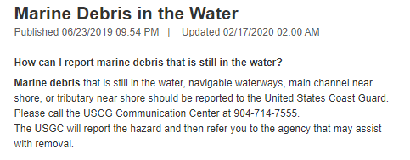
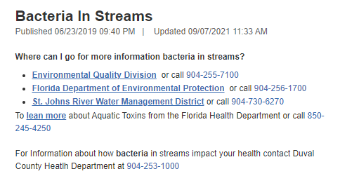
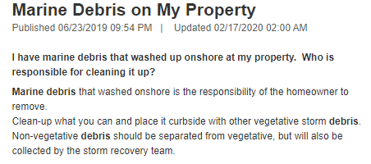
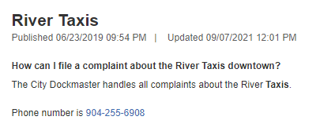
ANSWERS
7
Notes:
We currently have 6 answers to waterway related questions. We rely on the responsible area to provide us with updates and then ITD updates the information in the system. If we receive a call that we don’t have or can’t find the answer we create a general service request and a member of the 630-CITY team researches the answers and follows-up with the customer.

Slide 8
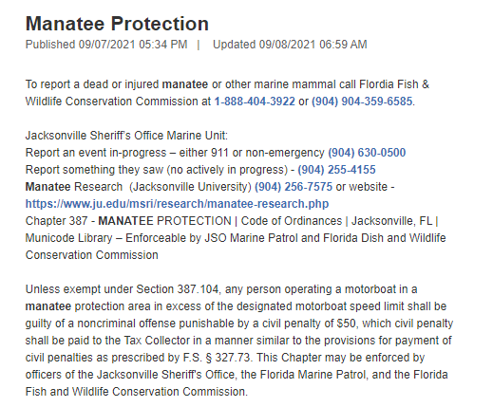
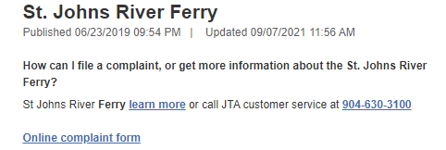
ANSWERS
8

Slide 9
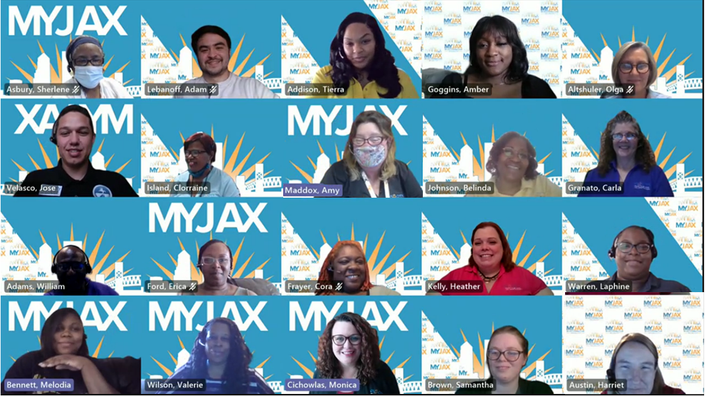
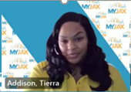
OUR MYJAX TEAM THANKS YOU!
Notes:
Meet the team

Slide 10
THANK YOU!

